Slide 1
Language Agnostic SPECIFICATION AND Verification For .NET
Manuel Fähndrich, Michael Barnett, Francesco Logozzo
http://codebox/contracts
http://research.microsoft.com/contracts

Slide 2
What are Code Contracts?
Standard, language-agnostic way to express
Preconditions
Postconditions
Object invariants
Tools for
Runtime checking of contracts
Documentation generation
Static verification

Slide 3
Goals for Code Contracts
Specify design decisions once Use many times…
Code documentation (in sync with code)
Documentation generation
Runtime checking
Static verification
Don’t change existing .NET dev environment
Languages, IDE, compilers, etc.
Provide a standard specification format
Enable tool eco-system around contracts
Provide value to programmers
Trade-off soundness and completeness

Slide 4
Embedded Contract Language Idea
Previous approaches
Eiffel, Spec#: non-mainstream languages
JML: specifications in comments
Attributes: [NotNull] @NonNull
Many research languages or extensions with
Specifications or type systems
New Alternative
Embedding in an existing language CodeContracts

Slide 5
Example
/// <summary> Removes suffix from original </summary>
///
public string TrimSuffix(string original, string suffix)
{
Contract.Requires(original != null);
Contract.Requires(!String.IsEmptyOrNull(suffix));
Contract.Ensures(!Contract.Result<string>().EndsWith(suffix));
var result = original
while (result.EndsWith(suffix))
{
result = result.Substring(0, result.Length – suffix.Length);
}
return result;
}

Slide 6
Example
/// <summary> Removes suffix from original </summary>
///
public string TrimSuffix(string original, string suffix)
{
Contract.Requires(original != null);
Contract.Requires(!String.IsEmptyOrNull(suffix));
Contract.Ensures(!Contract.Result<string>().EndsWith(suffix));
var result = original;
if (result.EndsWith(suffix))
{
result = result.Substring(0, result.Length – suffix.Length);
}
return result;
}

Slide 7
Example
/// <summary> Removes suffix from original </summary>
///
public string TrimSuffix(string original, string suffix)
{
Contract.Requires(original != null);
Contract.Requires(!String.IsEmptyOrNull(suffix));
Contract.Ensures(!Contract.Result<string>().EndsWith(suffix));
var result = original;
if (result.EndsWith(suffix))
{
result = result.Substring(0, result.Length – suffix.Length);
}
return result;
}

Slide 8
Example
/// <summary> Removes suffix from original </summary>
///
public string TrimSuffix(string original, string suffix)
{
Contract.Requires(original != null);
Contract.Requires(suffix != null);
Contract.Ensures(!Contract.Result<string>().EndsWith(suffix));
var result = original;
if (result.EndsWith(suffix))
{
result = result.Substring(0, result.Length – suffix.Length);
}
return result;
}

Slide 9
Example
/// <summary> Removes suffix from original </summary>
///
public string TrimSuffix(string original, string suffix)
{
Contract.Requires(original != null);
Contract.Requires(suffix != null);
Contract.Ensures(!Contract.Result<string>().EndsWith(suffix));
var result = original;
if (result.EndsWith(suffix))
{
result = result.Substring(0, result.Length – suffix.Length);
}
return result;
}

Slide 10
Code Contracts Overview
ccrewrite
cccheck
ccdocgen
ccrefgen
Tools
Contracts
BCL 4.0
Authoring
VS2010
Sandcastle
Presentation

Slide 11
Example
/// <summary> Removes suffix from original </summary>
///
public string TrimSuffix(string original, string suffix)
{
Contract.Requires(original != null);
Contract.Requires(suffix != null);
Contract.Ensures(!Contract.Result<string>().EndsWith(suffix));
var result = original;
if (result.EndsWith(suffix))
{
result = result.Substring(0, result.Length – suffix.Length);
}
return result;
}
2 Bugs

Slide 12
Example
/// <summary> Removes suffix from original </summary>
///
public string TrimSuffix(string original, string suffix)
{
Contract.Requires(original != null);
Contract.Requires(suffix != null);
Contract.Ensures(!Contract.Result<string>().EndsWith(suffix));
var result = original;
if (result.EndsWith(suffix))
{
result = result.Substring(0, result.Length – suffix.Length);
}
return result;
}
Bug 1
original = “foo” suffix = “”
result = “foo”

Slide 13
Example
/// <summary> Removes suffix from original </summary>
///
public string TrimSuffix(string original, string suffix)
{
Contract.Requires(original != null);
Contract.Requires(!String.IsEmptyOrNull(suffix));
Contract.Ensures(!Contract.Result<string>().EndsWith(suffix));
var result = original;
if (result.EndsWith(suffix))
{
result = result.Substring(0, result.Length – suffix.Length);
}
return result;
}
Strengthened
Precondition

Slide 14
Example
/// <summary> Removes suffix from original </summary>
///
public string TrimSuffix(string original, string suffix)
{
Contract.Requires(original != null);
Contract.Requires(!String.IsEmptyOrNull(suffix));
Contract.Ensures(!Contract.Result<string>().EndsWith(suffix));
var result = original;
if (result.EndsWith(suffix))
{
result = result.Substring(0, result.Length – suffix.Length);
}
return result;
}
Bug 2
original = “foo” suffix = “o”
result = “fo”

Slide 15
Example
/// <summary> Removes suffix from original </summary>
///
public string TrimSuffix(string original, string suffix)
{
Contract.Requires(original != null);
Contract.Requires(!String.IsEmptyOrNull(suffix));
Contract.Ensures(!Contract.Result<string>().EndsWith(suffix));
var result = original;
while (result.EndsWith(suffix))
{
result = result.Substring(0, result.Length – suffix.Length);
}
return result;
}
Handle repeated
suffixes

Slide 16
Contracts Authored as Code
Boolean expression in source language
No new language
Full expressiveness
No new IDE, compiler, or parser
Yet, full IDE support (intellisense, refactoring, errors, debugging)
Semantics of boolean expressions
Given by compiler translation to ECMA MSIL
Persisted compiled contract format
Metadata + IL

Slide 17
Contract API in .NET 4.0
namespace System.Diagnostics.Contracts {
public static class Contract
{
[Conditional(“CONTRACTS_FULL”)]
public static void Requires(bool condition) {}
[Conditional(“CONTRACTS_FULL”)]
public static void Ensures(bool condition) {}
[Conditional(“CONTRACTS_FULL”)]
public static void Invariant(bool condition) {}
public static T Result<T>() {…}
public static T OldValue<T>(T expression) {…}
…
}
}
Library reusable from C#, VisualBasic, F#, …

Slide 18
Expressiveness: Quantifiers
/// <summary> Removes suffix from original </summary>
///
public string TrimSuffix(string original, string suffix)
{
Contract.Requires(original != null);
Contract.Requires(!String.IsEmptyOrNull(suffix));
Contract.Ensures(!Contract.Result<string>().EndsWith(suffix));
Contract.Ensures(Contract.ForAll(0,
Contract.Result<string>().Length,
i => Contract.Result<string>()[i] == original[i]));
}

Slide 19
Interface Contracts
[ContractClass(typeof(IListContract<>))]
public interface IList<T> : ICollection<T>
{
…
void RemoveAt(int index);
}
[ContractClassFor(typeof(IList<>))]
public class IListContract<T> : IList<T>
{
…
public void RemoveAt(int index)
{
Contract.Requires(index >= 0);
Contract.Requires(index < this.Count);
Contract.Ensures(this.Count == Contract.OldValue(this.Count) - 1);
}
}

Slide 20
Interface Contracts
[ContractClass(typeof(IListContract<>))]
public interface IList<T> : ICollection<T>
{
…
void RemoveAt(int index);
}
[ContractClassFor(typeof(IList<>))]
public class IListContract<T> : IList<T>
{
…
public void RemoveAt(int index)
{
Contract.Requires(index >= 0);
Contract.Requires(index < this.Count);
Contract.Ensures(this.Count == Contract.OldValue(this.Count) - 1);
}
}

Slide 21
Interface Contracts
[ContractClass(typeof(IListContract<>))]
public interface IList<T> : ICollection<T>
{
…
void RemoveAt(int index);
}
[ContractClassFor(typeof(IList<>))]
public class IListContract<T> : IList<T>
{
…
public void RemoveAt(int index)
{
Contract.Requires(index >= 0);
Contract.Requires(index < this.Count);
Contract.Ensures(this.Count == Contract.OldValue(this.Count) - 1);
}
}

Slide 22
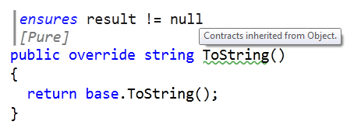
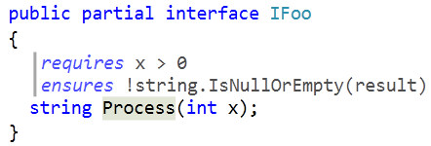
Contract Adornments (VS2010)
Shows inherited contracts
Shows interface contracts on interface

Slide 23
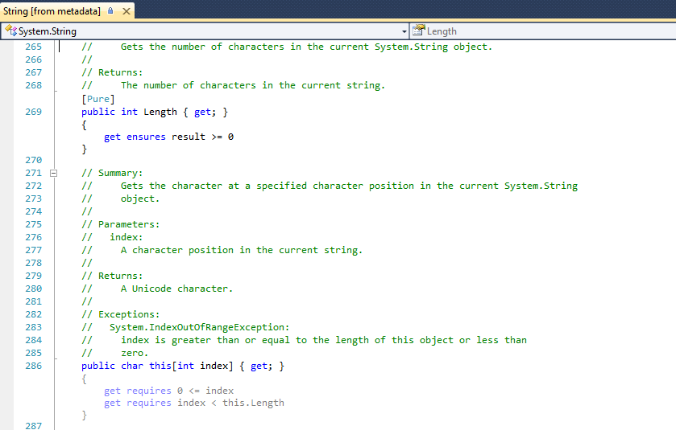
See Contracts on Metadata

Slide 24
Object Invariants
public class MyCollection
{
///<summary>data is never null<summary>
int[] data;
///<summary>count is non-negative and less equal data.Length<summary>
int count;
[ContractInvariantMethod]
void DataCountInvariants() {
Contract.Invariant( data != null );
Contract.Invariant( count >= 0 );
Contract.Invariant( count <= data.Length );
}
}

Slide 25
Object Invariants
public class MyCollection
{
///<summary>data is never null<summary>
int[] data;
///<summary>count is non-negative and less equal data.Length<summary>
int count;
[ContractInvariantMethod]
void DataCountInvariants() {
Contract.Invariant( data != null );
Contract.Invariant( count >= 0 );
Contract.Invariant( count <= data.Length );
}
}

Slide 26
Purity
Contract expression should have no observable side effects
Current practice with Asserts
Checked locally
Pure Methods
Purity of methods is declared [Pure]
Calls to pure methods allowed in contracts
Purity of methods unchecked

Slide 27
Drawbacks of Approach
Encodings necessary for missing constructs
Result, OldValue, ValueAtReturn
Interface and abstract buddy classes
Contract extraction / decompilation from IL
Closures + closure instantiation
Field initialization in constructors
Language specific idioms (C#, VB, F#)
… Yet, we wouldn’t be here if we had taken the new programming language path.

Slide 28
Code Contracts Overview
ccrewrite
cccheck
ccdocgen
ccrefgen
Tools
Contracts
BCL 4.0
Authoring
VS2010
Sandcastle
Presentation

Slide 29

Runtime Contract Checking
public virtual int Add(object value)
{
Contract.Requires(object != null);
Contract.Ensures( Count == Contract.Old(Count) + 1 );
Contract.Ensures( Contract.Result<int>() == Contract.OldValue(Count) );
if (_size == _items.Length) EnsuresCapacity(_size + 1);
_items[_size] = value;
return _size++;
}
public virtual int Add(object value)
{
Contract.Requires(object != null);
Contract.Ensures( Count == Contract.Old(Count) + 1 );
Contract.Ensures( Contract.Result<int>() == Contract.OldValue(Count) );
if (_size == _items.Length) EnsuresCapacity(_size + 1);
_items[_size] = value;
return _size++;
}
Executable runtime
Contract checking
csc
/d:CONTRACTS_FULL
.method public hidebysig newslot virtual instance int32 Add(object 'value') cil managed
{
.locals init (int32 'Contract.Old(Count)',
int32 'Contract.Result<int>()')
ldarg.1
ldnull
ceq
ldc.i4.0
ceq
ldstr "value != null"
call void __RewriterMethods::RewriterRequires$PST06000009(bool, string)ldarg.0
ldarg.0
call instance int32 TabDemo.BaseList::get_Count()
stloc.3
ldarg.0
ldfld int32 TabDemo.BaseList::count
ldarg.0
ldfld object[] TabDemo.BaseList::items
ldlen
conv.i4
ceq
ldc.i4.0
ceq
stloc.1
ldloc.1
brtrue IL_004d
nop
ldarg.0
ldarg.0
ldfld int32 TabDemo.BaseList::count
ldc.i4.1
add
call instance void TabDemo.BaseList::EnsureCapacity(int32)
nop
nop
ldarg.0
ldfld object[] TabDemo.BaseList::items
ldarg.0
ldfld int32 TabDemo.BaseList::count
ldarg.1
stelem.ref
ldarg.0
dup
ldfld int32 TabDemo.BaseList::count
dup
stloc.2
ldc.i4.1
add
stfld int32 TabDemo.BaseList::count
ldloc.2
stloc.0
br IL_0072
ldloc.0
stloc.s 'Contract.Result<int>()'
br IL_007a
ldarg.0
call instance int32 TabDemo.BaseList::get_Count()
ldloc.3
ldc.i4.1
add
ceq
ldstr "Count == Contract.Old(Count) + 1"
call void __RewriterMethods::RewriterEnsures$PST0600000B(bool, string)
ldloc.s 'Contract.Result<int>()'
ldloc.s V_4
ceq
ldstr "Contract.Result<int>() == Contract.Old(Count)"
call void __RewriterMethods::RewriterEnsures$PST0600000B(bool, string)
ldloc.s 'Contract.Result<int>()'
ret
}
.method public hidebysig newslot virtual instance int32 Add(object 'value') cil managed
{
ldarg.1
ldnull
ceq
ldc.i4.0
ceq
call void [Microsoft.Contracts]Microsoft.Contracts.Contract::Requires(bool)
ldarg.0
call instance int32 TabDemo.BaseList::get_Count()
ldarg.0
call instance int32 TabDemo.BaseList::get_Count()
call !!0 [Microsoft.Contracts]Microsoft.Contracts.Contract::Old<int32>(!!0)
ldc.i4.1
add
ceq
call void [Microsoft.Contracts]Microsoft.Contracts.Contract::Ensures(bool)
call !!0 [Microsoft.Contracts]Microsoft.Contracts.Contract::Result<int32>()
ldarg.0
call instance int32 TabDemo.BaseList::get_Count()
call !!0 [Microsoft.Contracts]Microsoft.Contracts.Contract::Old<int32>(!!0)
ceq
call void [Microsoft.Contracts]Microsoft.Contracts.Contract::Ensures(bool)
ldarg.0
ldfld int32 TabDemo.BaseList::count
ldarg.0
ldfld object[] TabDemo.BaseList::items
ldlen
conv.i4
ceq
ldc.i4.0
ceq
stloc.1
ldloc.1
brtrue.s IL_0069
ldarg.0
ldarg.0
ldfld int32 TabDemo.BaseList::count
ldc.i4.1
add
call instance void TabDemo.BaseList::EnsureCapacity(int32)
ldarg.0
ldfld object[] TabDemo.BaseList::items
ldarg.0
ldfld int32 TabDemo.BaseList::count
ldarg.1
stelem.ref
ldarg.0
dup
ldfld int32 TabDemo.BaseList::count
dup
stloc.2
ldc.i4.1
add
stfld int32 TabDemo.BaseList::count
ldloc.2
stloc.0
br.s IL_008b
ldloc.0
ret
} // end of method BaseList::Add
csc normal compile
.method public hidebysig newslot virtual instance int32 Add(object 'value') cil managed
{
ldarg.0
ldfld int32 TabDemo.BaseList::count
ldarg.0
ldfld object[] TabDemo.BaseList::items
ldlen
conv.i4
ceq
ldc.i4.0
ceq
stloc.1
ldloc.1
brtrue.s IL_0029
ldarg.0
ldarg.0
ldfld int32 TabDemo.BaseList::count
ldc.i4.1
add
call instance void TabDemo.BaseList::EnsureCapacity(int32)
ldarg.0
ldfld object[] TabDemo.BaseList::items
ldarg.0
ldfld int32 TabDemo.BaseList::count
ldarg.1
stelem.ref
ldarg.0
dup
ldfld int32 TabDemo.BaseList::count
dup
stloc.2
ldc.i4.1
add
stfld int32 TabDemo.BaseList::count
ldloc.2
stloc.0
br.s IL_004b
ldloc.0
ret
}
ccrewrite
WF checks
Inheritance
Invariants
Source text

Slide 30
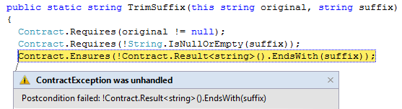
Runtime Checking Experience
Stepping, breakpoints work naturally
Runtime failure behavior fully configurable
Failing condition string available at runtime

Slide 31
Runtime Checking Functionality
Inheritance
Base and interfaces
Granularity knobs
Which checks are inserted
Closures and Iterators
Call-site checking
Recursion guards
Source text extraction
Debug experience / stepping / breakpoints

Slide 32
Challenges
Instrumentation in presence of generics/closures
Copying of contracts
Concurrency
Contracts specify non-interleaved behavior
Contracts on shared state may produce races
Inheritance may cause unexpected races
Notion of “thread-safe” is simplistic as it changes contracts
Caller side locking works better

Slide 33

Contract Reference Assemblies
public virtual int Add(object value)
{
Contract.Requires(object != null);
Contract.Ensures( Count == Contract.Old(Count) + 1 );
Contract.Ensures( Contract.Result<int>() == Contract.OldValue(Count) );
if (_size == _items.Length) EnsuresCapacity(_size + 1);
_items[_size] = value;
return _size++;
}
public virtual int Add(object value)
{
Contract.Requires(object != null);
Contract.Ensures( Count == Contract.Old(Count) + 1 );
Contract.Ensures( Contract.Result<int>() == Contract.OldValue(Count) );
if (_size == _items.Length) EnsuresCapacity(_size + 1);
_items[_size] = value;
return _size++;
}
Compile
/d:CONTRACTS_FULL
Contract Reference Assembly
.method public hidebysig newslot virtual instance int32 Add(object 'value') cil managed
{
ldarg.1
ldnull
ceq
ldc.i4.0
ceq
call void [Microsoft.Contracts]Microsoft.Contracts.Contract::Requires(bool)
ldarg.0
call instance int32 TabDemo.BaseList::get_Count()
ldarg.0
call instance int32 TabDemo.BaseList::get_Count()
call !!0 [Microsoft.Contracts]Microsoft.Contracts.Contract::Old<int32>(!!0)
ldc.i4.1
add
ceq
call void [Microsoft.Contracts]Microsoft.Contracts.Contract::Ensures(bool)
call !!0 [Microsoft.Contracts]Microsoft.Contracts.Contract::Result<int32>()
ldarg.0
call instance int32 TabDemo.BaseList::get_Count()
call !!0 [Microsoft.Contracts]Microsoft.Contracts.Contract::Old<int32>(!!0)
ceq
call void [Microsoft.Contracts]Microsoft.Contracts.Contract::Ensures(bool)
ldarg.0
ldfld int32 TabDemo.BaseList::count
ldarg.0
ldfld object[] TabDemo.BaseList::items
ldlen
conv.i4
ceq
ldc.i4.0
ceq
stloc.1
ldloc.1
brtrue.s IL_0069
ldarg.0
ldarg.0
ldfld int32 TabDemo.BaseList::count
ldc.i4.1
add
call instance void TabDemo.BaseList::EnsureCapacity(int32)
ldarg.0
ldfld object[] TabDemo.BaseList::items
ldarg.0
ldfld int32 TabDemo.BaseList::count
ldarg.1
stelem.ref
ldarg.0
dup
ldfld int32 TabDemo.BaseList::count
dup
stloc.2
ldc.i4.1
add
stfld int32 TabDemo.BaseList::count
ldloc.2
stloc.0
br.s IL_008b
ldloc.0
ret
} // end of method BaseList::Add
.method public hidebysig newslot virtual instance int32 Add(object 'value') cil managed
{
ldarg.1
ldnull
ceq
ldc.i4.0
ceq
call void [Microsoft.Contracts]Microsoft.Contracts.Contract::Requires(bool)
ldarg.0
call instance int32 TabDemo.BaseList::get_Count()
ldarg.0
call instance int32 TabDemo.BaseList::get_Count()
call !!0 [Microsoft.Contracts]Microsoft.Contracts.Contract::Old<int32>(!!0)
ldc.i4.1
add
ceq
call void [Microsoft.Contracts]Microsoft.Contracts.Contract::Ensures(bool)
call !!0 [Microsoft.Contracts]Microsoft.Contracts.Contract::Result<int32>()
ldarg.0
call instance int32 TabDemo.BaseList::get_Count()
call !!0 [Microsoft.Contracts]Microsoft.Contracts.Contract::Old<int32>(!!0)
ceq
call void [Microsoft.Contracts]Microsoft.Contracts.Contract::Ensures(bool)
} // end of method BaseList::Add
ccrefgen
Language-agnostic, persisted contract format
Free: produced by all compilers
Semantics given by MSIL encoding conditions
Uniform format to down-stream tools
Library for extracting contracts from MSIL

Slide 34
Contract Reference Assemblies
Contract Reference Assemblies
.method public hidebysig newslot virtual instance int32 Add(object 'value') cil managed
{
ldarg.1
ldnull
ceq
ldc.i4.0
ceq
call void [Microsoft.Contracts]Microsoft.Contracts.Contract::Requires(bool)
ldarg.0
call instance int32 TabDemo.BaseList::get_Count()
ldarg.0
call instance int32 TabDemo.BaseList::get_Count()
call !!0 [Microsoft.Contracts]Microsoft.Contracts.Contract::Old<int32>(!!0)
ldc.i4.1
add
ceq
call void [Microsoft.Contracts]Microsoft.Contracts.Contract::Ensures(bool)
call !!0 [Microsoft.Contracts]Microsoft.Contracts.Contract::Result<int32>()
ldarg.0
call instance int32 TabDemo.BaseList::get_Count()
call !!0 [Microsoft.Contracts]Microsoft.Contracts.Contract::Old<int32>(!!0)
ceq
call void [Microsoft.Contracts]Microsoft.Contracts.Contract::Ensures(bool)
ldarg.0
ldfld int32 TabDemo.BaseList::count
ldarg.0
ldfld object[] TabDemo.BaseList::items
ldlen
conv.i4
ceq
ldc.i4.0
ceq
stloc.1
ldloc.1
brtrue.s IL_0069
ldarg.0
ldarg.0
ldfld int32 TabDemo.BaseList::count
ldc.i4.1
add
call instance void TabDemo.BaseList::EnsureCapacity(int32)
ldarg.0
ldfld object[] TabDemo.BaseList::items
ldarg.0
ldfld int32 TabDemo.BaseList::count
ldarg.1
stelem.ref
ldarg.0
dup
ldfld int32 TabDemo.BaseList::count
dup
stloc.2
ldc.i4.1
add
stfld int32 TabDemo.BaseList::count
ldloc.2
stloc.0
br.s IL_008b
ldloc.0
ret
} // end of method BaseList::Add
ccrewrite
Runtime checks
cccheck
Compile-time warnings
ccdocgen
Augmented Xml doc

Slide 35
Providing Contracts for your Lib
src
src
src
src
Release Assemblies
Contract Reference Assemblies
PowerLib.dll
PowerLib.Contracts.dll
+
(minimal runtime checks)
All contracts, no code

Slide 36
Developing against 3rd Party Lib
can check Requires of PowerLib at call-sites
inherits contracts
src
src
src
MyApp.exe
MyApp.exe
src
ccrewrite
PowerLib.Contracts.dll
PowerLib.dll
(no runtime checks)

Slide 37
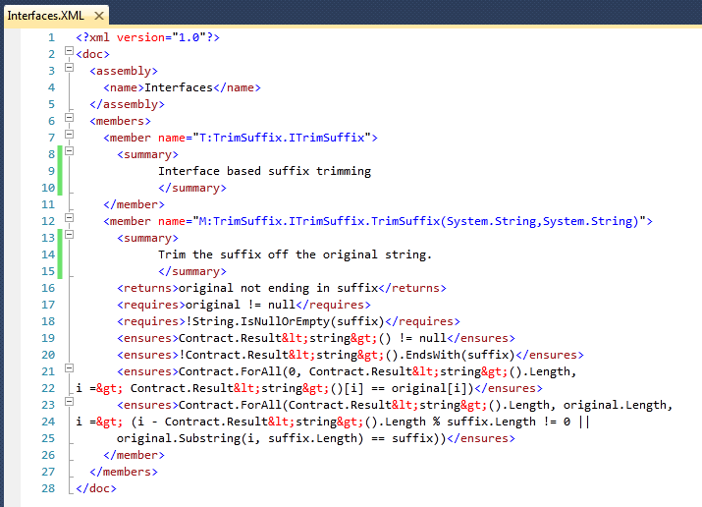
Documentation Generation
ccdocgen augments XML doc file with contract elements
Enables any other tool to read them
XSLT patches for Sandcastle prototyped

Slide 38
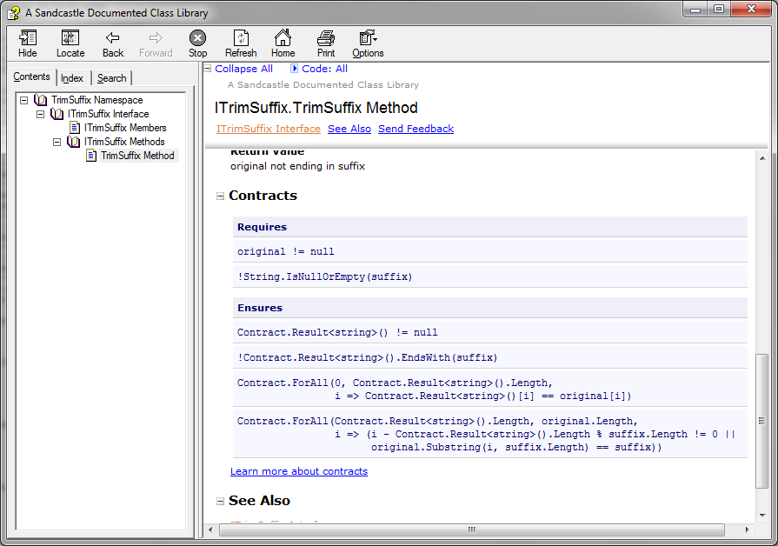
Doc Generation with Sandcastle

Slide 39
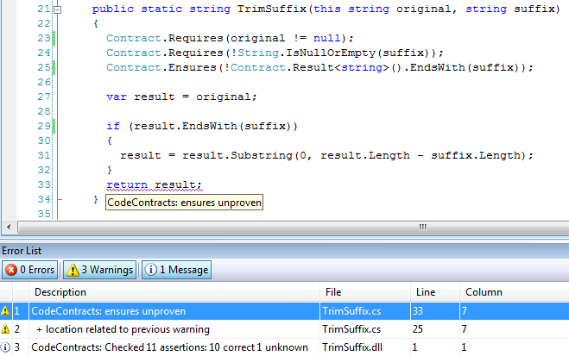
Static Contract Verification

Slide 40
Practical Matters
The legacy-requires saga
Interaction with other tools
CodeAnalysis / FxCop
Code coverage
Postsharper
Suppressing warnings / functionality
Contract.Assume(…), Attributes
Dealing with all of .NET
Silverlight, ASP.NET, Office.NET, Windows Phone 7, …

Slide 41
The Legacy Requires Saga 1
[ContractClass(typeof(IListContract<>))]
public int Sum(ICollection<int> values)
{
if (values == null) {
throw new ArgumentNullException(“values”, Resource.Lookup…);
…
}
[ContractClassFor(typeof(IList<>))]
public class IListContract<T> : IList<T>
{
…
public void RemoveAt(int index)
{
Contract.Requires(index >= 0);
Contract.Requires(index < this.Count);
Contract.Ensures(this.Count == Contract.OldValue(this.Count) - 1);
}
}

Slide 42
The Legacy Requires Saga 2
[ContractClass(typeof(IListContract<>))]
public int Sum(ICollection<int> values)
{
if (values == null) {
throw new ArgumentNullException(“values”, Resource.Lookup…);
Contract.EndContractBlock();
…
}
[ContractClassFor(typeof(IList<>))]
public class IListContract<T> : IList<T>
{
…
public void RemoveAt(int index)
{
Contract.Requires(index >= 0);
Contract.Requires(index < this.Count);
Contract.Ensures(this.Count == Contract.OldValue(this.Count) - 1);
}
}
Decompiled as
Requires( values != null );

Slide 43
The Legacy Requires Saga 3
[ContractClass(typeof(IListContract<>))]
public int Sum(ICollection<int> values)
{
Helpers.CheckNull(values, “values”);
…
}
class Helpers {
c public static void CheckNull(object object, string name) {
if (object == null) {
throw new ArgumentNullException(name, Resource.Lookup…);
}class IListContract<T> : IList<T>
{
…
public void RemoveAt(int index)
{
Contract.Requires(index >= 0);
Contract.Requires(index < this.Count);
Contract.Ensures(this.Count == Contract.OldValue(this.Count) - 1);
}
}

Slide 44
The Legacy Requires Saga 3
[ContractClass(typeof(IListContract<>))]
public int Sum(ICollection<int> values)
{
Helpers.CheckNull(values, “values”);
…
}
class Helpers {
[ContractArgumentValidator]
c public static void CheckNull(object object, string name) {
if (object == null) {
throw new ArgumentNullException(name, Resource.Lookup…);
Contract.EndContractBlock();
}class IListContract<T> : IList<T>
{
…
public void RemoveAt(int index)
{
Contract.Requires(index >= 0);
Contract.Requires(index < this.Count);
Contract.Ensures(this.Count == Contract.OldValue(this.Count) - 1);
}
}
Decompiled as
Requires( values != null );

Slide 45
Contract Format: Future Proof
Contracts as MSIL
Provides extension point
bool ProtectedBy<T>(ref T data, object lock);
No lock-in to particular tools
Language integration
C#, VB may provide syntax in the future, emit same format
CCrewrite
FxCop
CCCheck
Boogie
Coq, Isabelle
Prove Correct
Find Bugs

Slide 46
Partial Contracts for Existing Libraries
Mscorlib
System
System.Data
System.Xml
System.Windows
System.Core
System.Configuration
System.Web
System.Windows.Browser
System.Windows.Forms
WindowsBase
System.Drawing
System.Security
Microsoft.VisualBasic.Compatibility
System.Xml.Linq
Microsoft.VisualBasic

Slide 47
Questions?
Internal
http://codebox/contracts
External
http://msdn.microsoft.com/devlabs/dd491992.aspx
Mail
mailto:maf mailto:mbarnett mailto:logozzo

